Slide 1
BIG DATA WITH HADOOP
VISHNU PRIYA VR
S181165200254

Slide 2
OVERVIEW
BIG DATA
HADOOP
HISTORY
HADOOP ECOSYSTEM
*HDFS
*MAPREDUCE
HIVE, PIG, SQOOP, FLUME, HBASE, ZOOKEEPER,
OOZIE, YARN, SPARK.
CASE STUDY
CONCLUSION

Slide 3
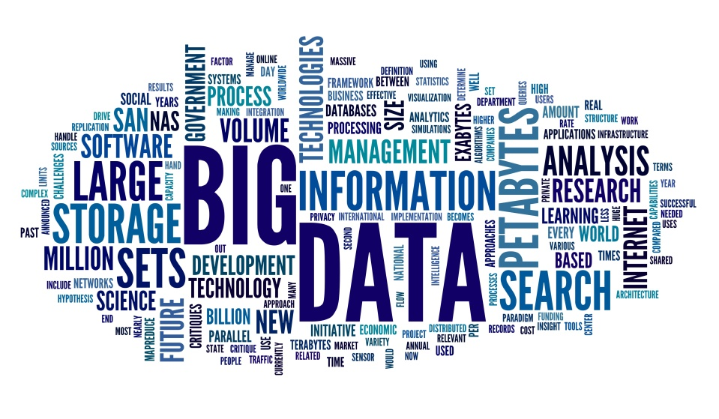
WHAT IS BIG DATA?

Slide 4
BIG DATA
Collection of data huge in size
Growing exponentially in a short period of time
Large and complex
Traditional data management tools cannot be used to store or processs the data effficiently

Slide 5
CHARACTERISTICS OF BIG DATA
5Vs of Big Data
VOLUME
VARIETY
VELOCITY
VERACITY
VALUE

Slide 6
CATEGORIES OF BIG DATA
Three forms of Big Data
Structured
Semi Structured
Unstructured

Slide 7
BENEFITS OF BIG DATA PROCESSING
Businesses can utilize outside intelligence while taking decisions.
Improved customer service.
Early identification of risk to the product/service,if any.
Better Operational Efficiency

Slide 8
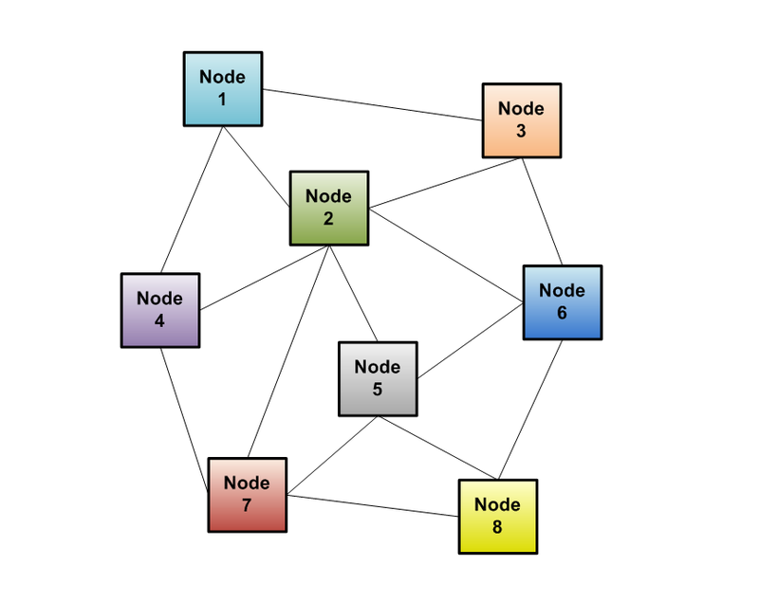
SOLUTION-DISTRIBUTED APPROACH

Slide 9
HADOOP
A new approach of the distributed system is called as Hadoop
HADOOP
- A scalable fault-tolerant distributed system for data storage and processing
Distribute data when the data is stored
Process data where the data is
Data is replicated

Slide 10
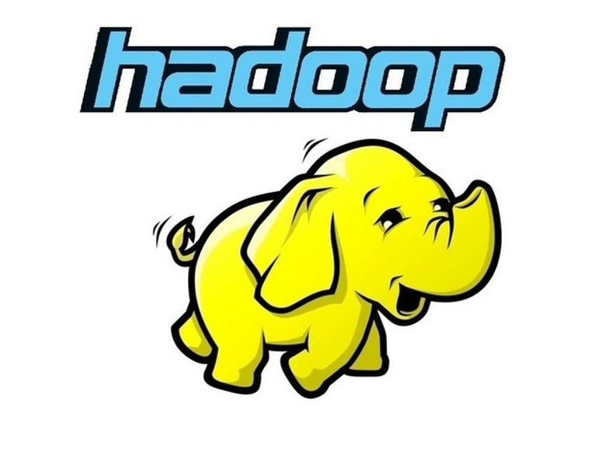
ABOUT HADOOP
Apache Hadoop is an open-source software framework for storage and large-scale processing of data-sets on clusters of commodity hardware.
Some of the characteristics:
Open source
Distributed processing
Distributed storage
Scalable
Reliable
Fault-tolerant
Economical
Flexible

Slide 11
HADOOP COMPONENTS
HDFS -> Hadoop Distributed File System
YARN-> Yet Another Resource Negotiator
MapReduce-> Data processing using programming
Spark-> In-memory Data Processing
PIG, HIVE-> Data Processing Services using Query (SQL-like)
HBase-> NoSQL Database
Mahout, Spark MLlib -> Machine Learning
Apache Drill -> SQL on Hadoop
Zookeeper-> Managing Cluster
Oozie-> Job Scheduling
Flume, Sqoop -> Data Ingesting Services
Solr & Lucene -> Searching & Indexing
Ambari-> Provision, Monitor and Maintain cluster

Slide 12
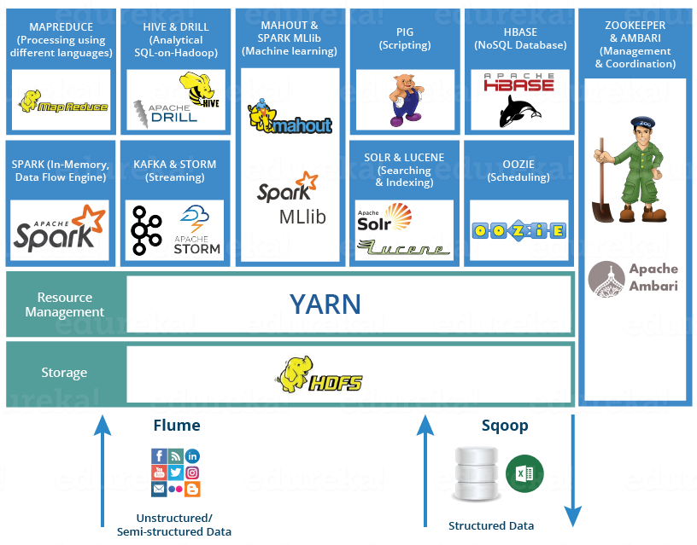
HADOOP ECOSYSTEM

Slide 13
HDFS
Hadoop Distributed File System is the core component or you can say, the backbone of Hadoop Ecosystem.
HDFS is the one, which makes it possible to store different types of large data sets (i.e. structured, unstructured and semi structured data).
HDFS creates a level of abstraction over the resources, from where we can see the whole HDFS as a single unit.
It helps us in storing our data across various nodes and maintaining the log file about the stored data (metadata).
HDFS has two core components, i.e. NameNode and DataNode.
The NameNode is the main node and it doesn’t store the actual data. It contains metadata, just like a log file or you can say as a table of content. Therefore, it requires less storage and high computational resources.
On the other hand, all your data is stored on the DataNodes and hence it requires more storage resources. These DataNodes are commodity hardware (like your laptops and desktops) in the distributed environment. That’s the reason, why Hadoop solutions are very cost effective.
You always communicate to the NameNode while writing the data. Then, it internally sends a request to the client to store and replicate data on various DataNodes.

Slide 14
YARN
Consider YARN as the brain of your Hadoop Ecosystem. It performs all your processing activities by allocating resources and scheduling tasks.
It has two major components, i.e. ResourceManager and NodeManager.
ResourceManager is again a main node in the processing department.
It receives the processing requests, and then passes the parts of requests to corresponding NodeManagers accordingly, where the actual processing takes place.
NodeManagers are installed on every DataNode. It is responsible for execution of task on every single DataNode.
Schedulers: Based on your application resource requirements, Schedulers perform scheduling algorithms and allocates the resources.
ApplicationsManager: While ApplicationsManager accepts the job submission, negotiates to containers (i.e. the Data node environment where process executes) for executing the application specific ApplicationMaster and monitoring the progress. ApplicationMasters are the deamons which reside on DataNode and communicates to containers for execution of tasks on each DataNode.ResourceManager has two components, i.e. Schedulers and ApplicationsManager.

Slide 15

MAPREDUCE
It is the core component of processing in a Hadoop Ecosystem as it provides the logic of processing. In other words, MapReduce is a software framework which helps in writing applications that processes large data sets using distributed and parallel algorithms inside Hadoop environment.
In a MapReduce program, Map() and Reduce() are two functions.
The Map function performs actions like filtering, grouping and sorting.
While Reduce function aggregates and summarizes the result produced by map function.
The result generated by the Map function is a key value pair (K, V) which acts as the input for Reduce function.

Slide 16

PIG
PIG has two parts: Pig Latin, the language and the pig runtime, for the execution environment. You can better understand it as Java and JVM.
It supports pig latin language, which has SQL like command structure.
10 line of pig latin = approx. 200 lines of Map-Reduce Java code
The compiler internally converts pig latin to MapReduce. It produces a sequential set of MapReduce jobs, and that’s an abstraction (which works like black box).
PIG was initially developed by Yahoo.
It gives you a platform for building data flow for ETL (Extract, Transform and Load), processing and analyzing huge data sets.

Slide 17

HIVE
Facebook created HIVE for people who are fluent with SQL. Thus, HIVE makes them feel at home while working in a Hadoop Ecosystem.
Basically, HIVE is a data warehousing component which performs reading, writing and managing large data sets in a distributed environment using SQL-like interface.
HIVE + SQL = HQL
The query language of Hive is called Hive Query Language(HQL), which is very similar like SQL.
It has 2 basic components: Hive Command Line and JDBC/ODBC driver.
The Hive Command line interface is used to execute HQL commands.
While, Java Database Connectivity (JDBC) and Object Database Connectivity (ODBC) is used to establish connection from data storage.
Secondly, Hive is highly scalable. As, it can serve both the purposes, i.e. large data set processing (i.e. Batch query processing) and real time processing (i.e. Interactive query processing).
It supports all primitive data types of SQL.
We can use predefined functions, or write tailored user defined functions (UDF) also to accomplish your specific needs.

Slide 18

OOZIE
Consider Apache Oozie as a clock and alarm service inside Hadoop Ecosystem. For Apache jobs, Oozie has been just like a scheduler. It schedules Hadoop jobs and binds them together as one logical work.
There are two kinds of Oozie jobs:
Oozie workflow: These are sequential set of actions to be executed. You can assume it as a relay race. Where each athlete waits for the last one to complete his part.
Oozie Coordinator: These are the Oozie jobs which are triggered when the data is made available to it. Think of this as the response-stimuli system in our body. In the same manner as we respond to an external stimulus, an Oozie coordinator responds to the availability of data and it rests otherwise.

Slide 19

FLUME
Ingesting data is an important part of our Hadoop Ecosystem.
The Flume is a service which helps in ingesting unstructured and semi-structured data into HDFS.
It gives us a solution which is reliable and distributed and helps us in collecting, aggregating and moving large amount of data sets.
It helps us to ingest online streaming data from various sources like network traffic, social media, email messages, log files etc. in HDFS.
There is a Flume agent which ingests the streaming data from various data sources to HDFS.
The flume agent has 3 components: source, sink and channel.
Source: it accepts the data from the incoming streamline and stores the data in the channel.
Channel: it acts as the local storage or the primary storage. A Channel is a temporary storage between the source of data and persistent data in the HDFS.
Sink: Then, our last component i.e. Sink, collects the data from the channel and commits or writes the data in the HDFS permanently.

Slide 20

SQOOP
The major difference between Flume and Sqoop is that:
Flume only ingests unstructured data or semi-structured data into HDFS.
While Sqoop can import as well as export structured data from RDBMS or Enterprise data warehouses to HDFS or vice versa
When we submit Sqoop command, our main task gets divided into sub tasks which is handled by individual Map Task internally. Map Task is the sub task, which imports part of data to the Hadoop Ecosystem. Collectively, all Map tasks imports the whole data.
Export also works in a similar manner.
When we submit our Job, it is mapped into Map Tasks which brings the chunk of data from HDFS. These chunks are exported to a structured data destination. Combining all these exported chunks of data, we receive the whole data at the destination, which in most of the cases is an RDBMS (MYSQL/Oracle/SQL Server).

Slide 21

ZOOKEEPER
Apache Zookeeper is the coordinator of any Hadoop job which includes a combination of various services in a Hadoop Ecosystem.
Apache Zookeeper coordinates with various services in a distributed environment.
Before Zookeeper, it was very difficult and time consuming to coordinate between different services in Hadoop Ecosystem. The services earlier had many problems with interactions like common configuration while synchronizing data. Even if the services are configured, changes in the configurations of the services make it complex and difficult to handle. The grouping and naming was also a time-consuming factor.
Due to the above problems, Zookeeper was introduced. It saves a lot of time by performing synchronization, configuratioN.

Slide 22
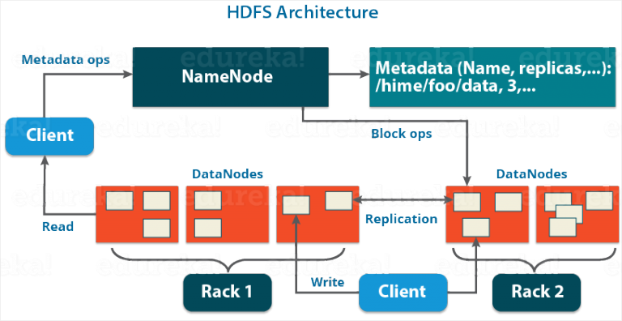
HADOOP HDFS ARCHITECTURE

Slide 23
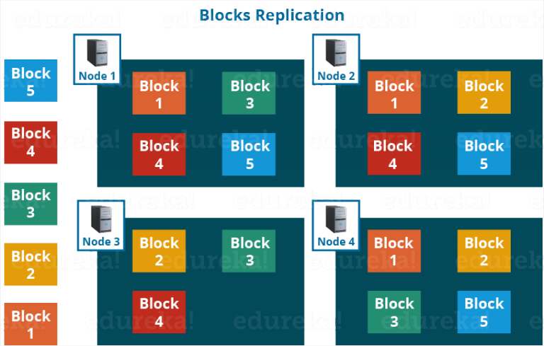
BLOCK REPLICATION

Slide 24
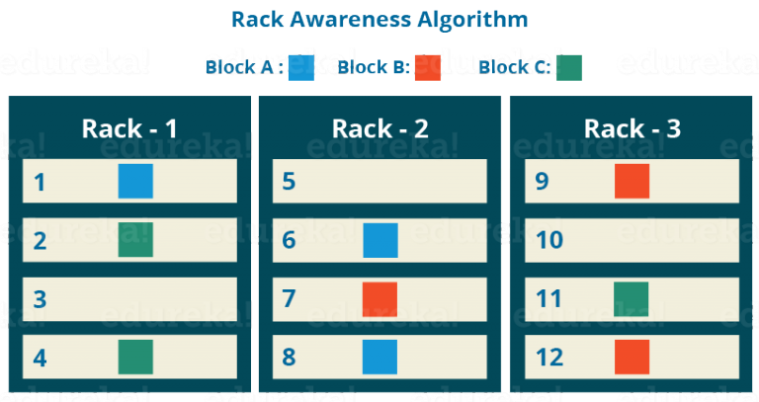
RACK AWARENESS

Slide 25
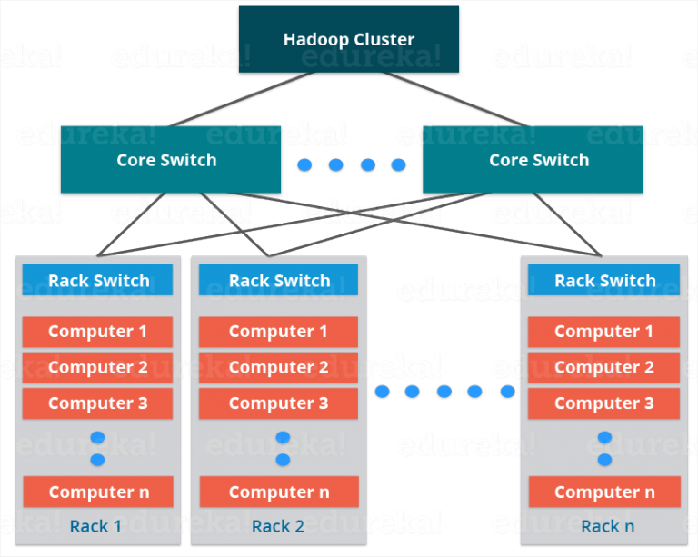
HADOOP CLUSTER

Slide 26
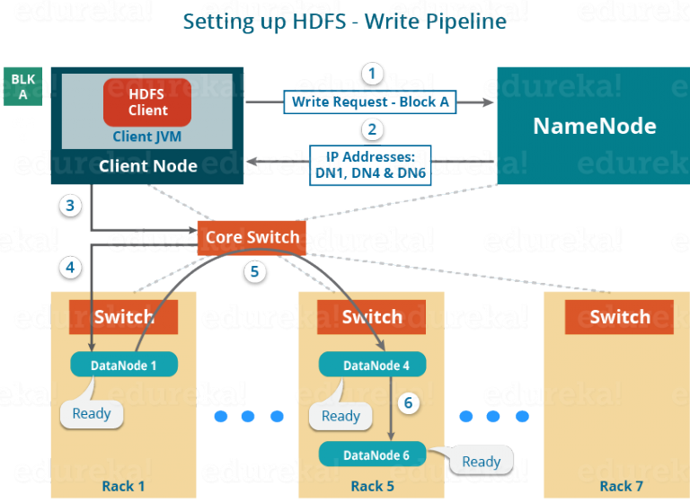
HDFS WRITE

Slide 27
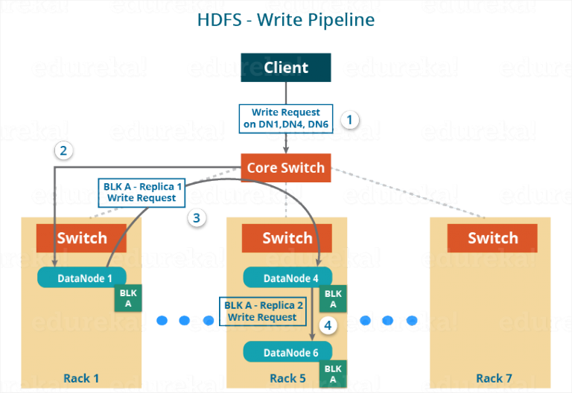
HDFS WRITE

Slide 28
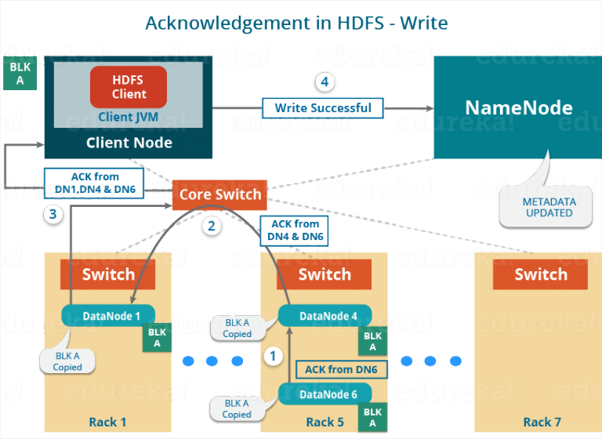
HDFS WRITE

Slide 29
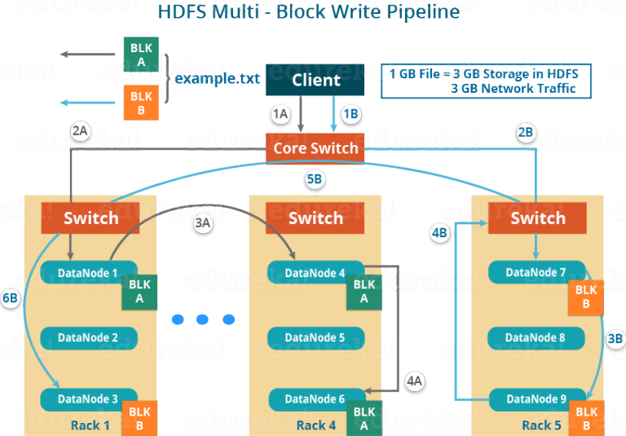
HDFS WRITE MULTI BLOCK

Slide 30
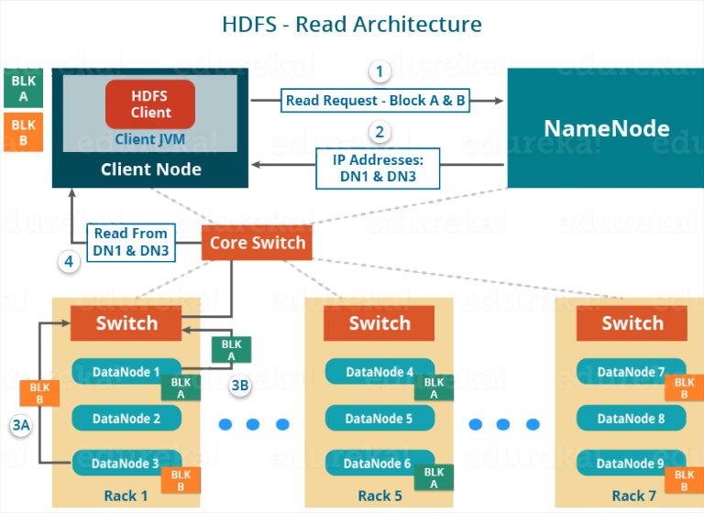
HDFS READ

Slide 31
CASE STUDY-H1B VISA
The H1B is an employment-based, non-immigrant visa category for temporary foreign workers in the United States.
For a foreign national to apply for H1B visa, an US employer must offer a job and petition for H1B visa with the US immigration department.
This is the most common visa status applied for and held by international students once they complete college/ higher education (Masters, Ph.D.) and work in a full-time position.
We will be performing analysis on the H1B visa applicants between the years 2011-2016
The dataset has nearly 3 million of records.
The dataset is in structured form.

Slide 32
DESCRIPTION OF THE DATASET
The dataset is provided by Office of Foreign Labour Certification and has nearly 3 million records.
There are 10 columns excluding the serial number, columns in the dataset include:
CASE_STATUS: Status associated with the last significant event or decision. Valid values include “Certified,” “Certified-Withdrawn,” Denied,” and “Withdrawn”.
EMPLOYER_NAME: Name of employer submitting labour condition application.
SOC_NAME: the Occupational name associated with the SOC_CODE. SOC_CODE is the occupational code associated with the job being requested for temporary labour condition, as classified by the Standard Occupational Classification (SOC) System.
JOB_TITLE: Title of the job
FULL_TIME_POSITION: Y = Full Time Position; N = Part Time Position
PREVAILING_WAGE: Prevailing Wage for the job being requested for temporary labour condition. The wage is listed at annual scale in USD. The prevailing wage for a job position is defined as the average wage paid to similarly employed workers in the requested occupation in the area of intended employment. The prevailing wage is based on the employer’s minimum requirements for the position.
YEAR: Year in which the H1B visa petition was filed
WORKSITE: City and State information of the foreign worker’s intended area of employment
lon: longitude of the Worksite
lat: latitude of the Worksite

Slide 33
CONCLUSION
Distributed File System
Parellel Data Processing
Key-Value Pairs
Varieties of data in a single architecture

